Slide 1
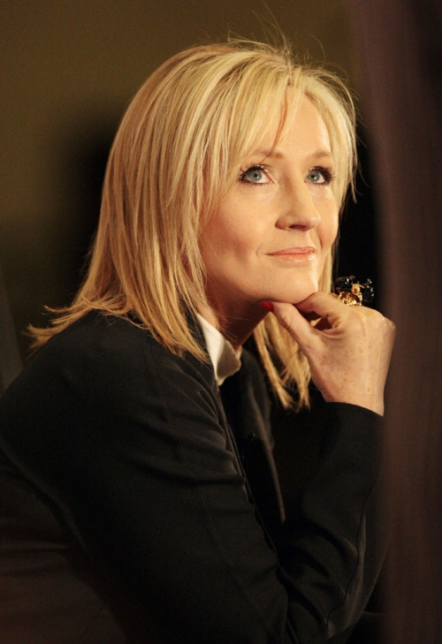
Her name is …
She is ….
She lives in …

Slide 2
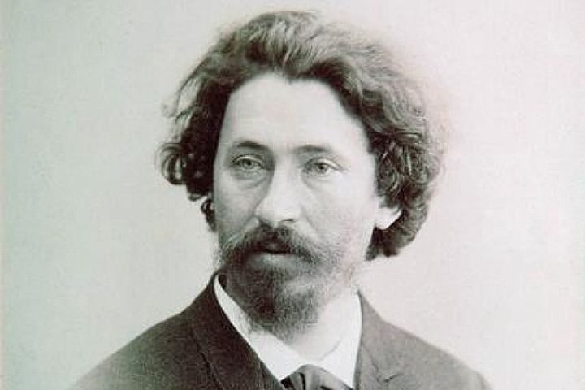
His name is …
He was ….
He lived in …

Slide 3
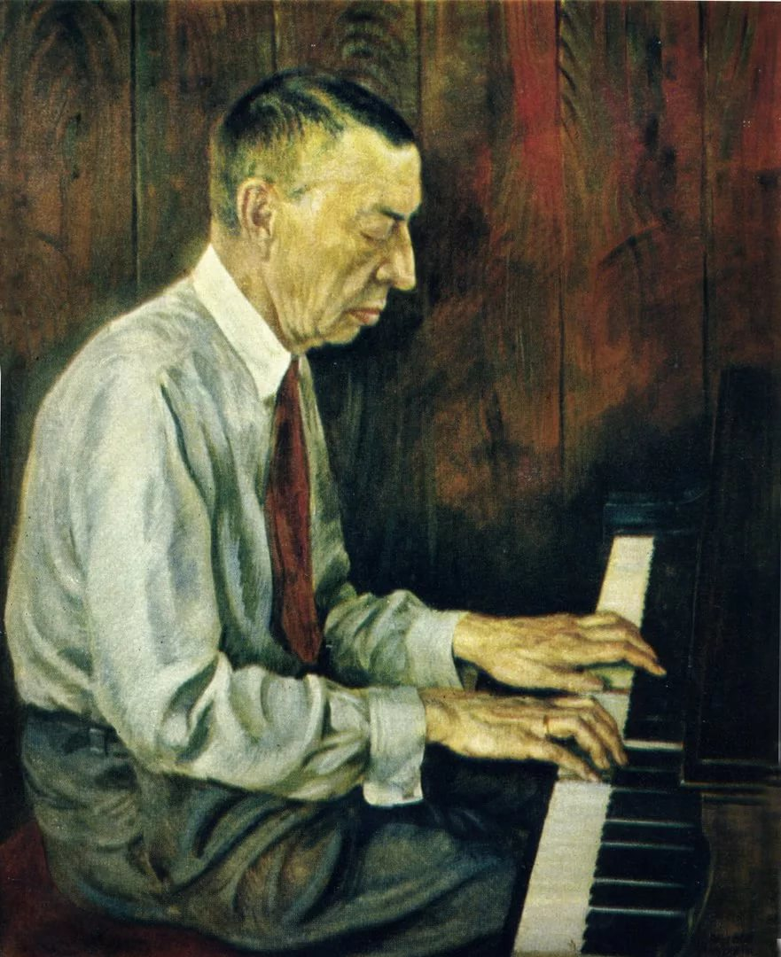
His name is …
He was ….
He lived in …

Slide 4
