Slide 2
Weather
10
20
30
40
50
Universe
10
20
30
40
50
Disasters
10
20
30
40
50
Grammar
10
20
30
40
50

Slide 3
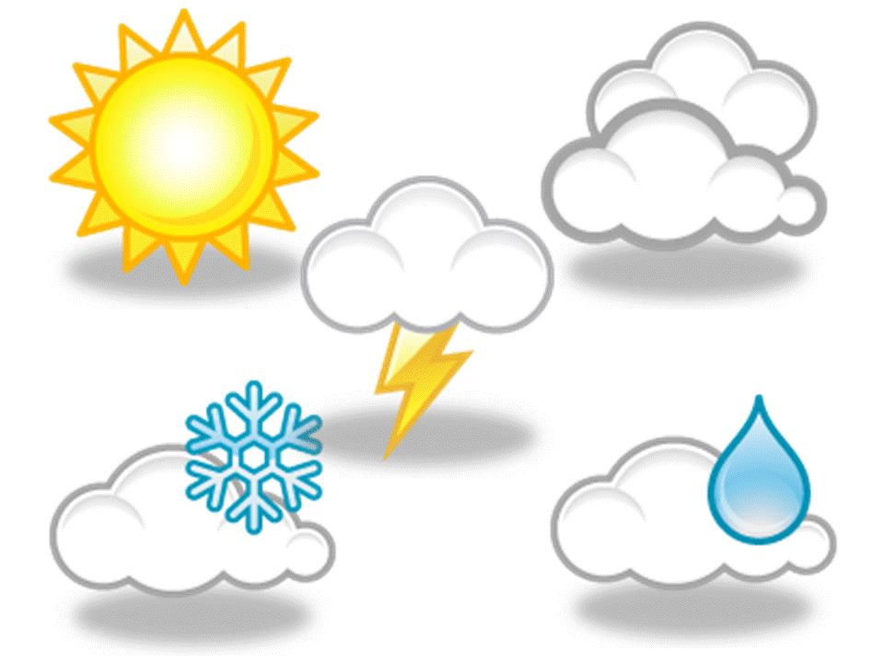
Say the names of the symbols
Sunny, cloudy, snowy, rainy, stormy
answer

Slide 4
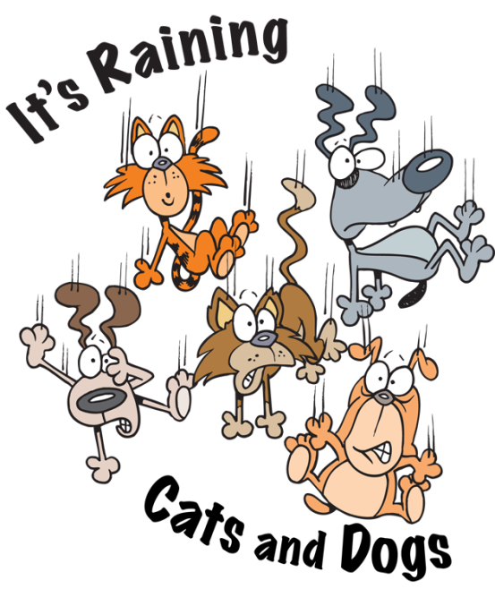
What do the British say when it’s raining heavily?
It’s raining cats and dogs
answer

Slide 5
Which scale for measuring temperature is used in the USA?
Fahrenheit
answer

Slide 6
Describe the weather in autumn
Rainy, cloudy, cold
answer

Slide 7
Say the temperature
- 6 ºC
It is 6 below zero. It is minus 6 degrees Centigrade
answer

Slide 8
The other name of the Earth
The Blue Planet
answer

Slide 9
What is all space and everything that exists in it?
The Universe
answer

Slide 10
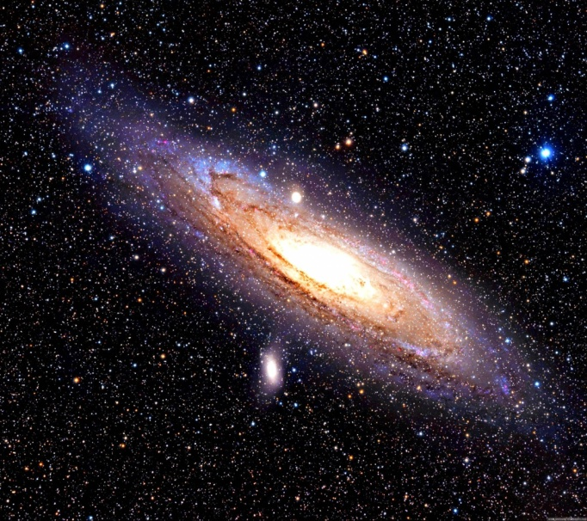
… is a huge group of stars and planets
The galaxy
answer

Slide 11
What is the difference between Milky Way and the Milky Way?
The Milky Way is a galaxy. Milky Way is a chocolate for children
answer

Slide 12
Why do people call the Earth “the Blue Planet”?
Nearly three quarters of the Earth are covered with water.
answer

Slide 13
A large amount of water which quickly covers a place that is usually a dry land
Flood
answer

Slide 14
A mountаin with а hole cаlled а сrater in thе top
Volcano
answer

Slide 15
A very violent wind in the form of a funnel of air that spins at great speed across land
Tornado
answer

Slide 16
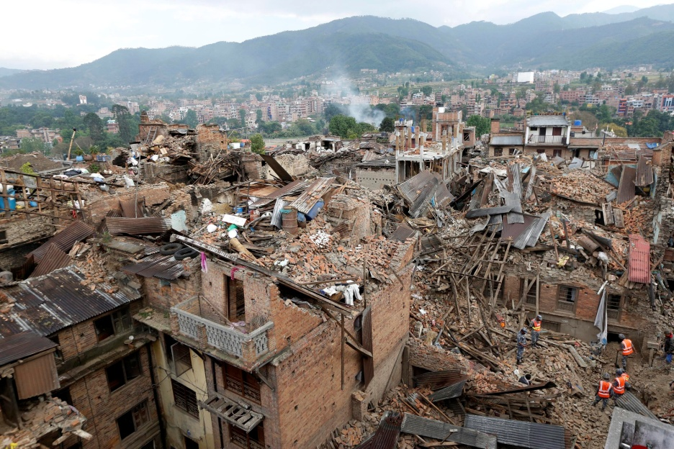
What is typical of the earthquake?
Is shaking of the ground
answer

Slide 17
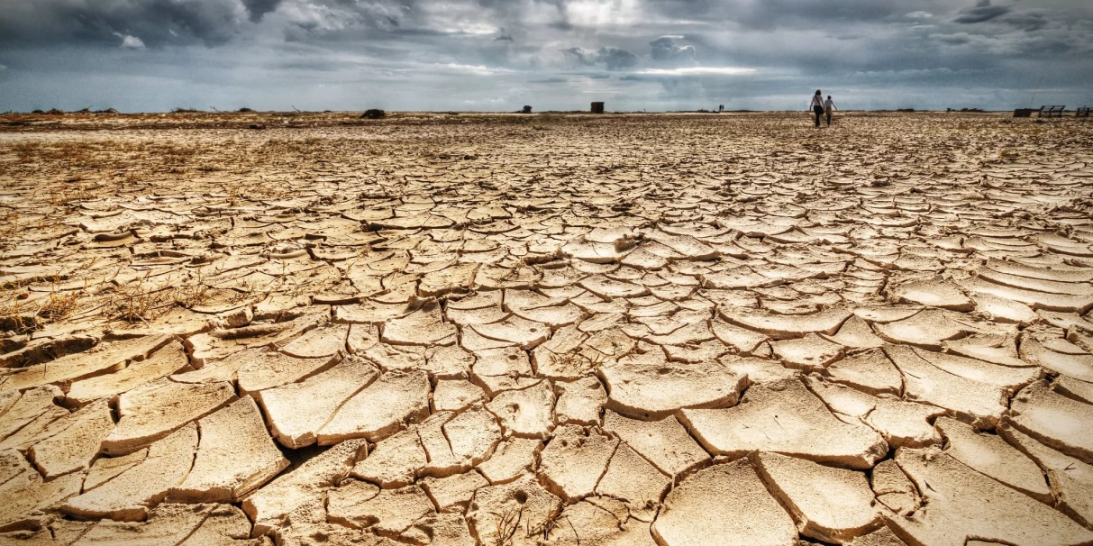
What is typical of the drought?
A long period of dry weather when there is not enough water
answer

Slide 18
Correct the mistake:
The astronauts was looking at the sky at 10 p.m. yesterday.
The astronauts were looking at the sky at 10 p.m. yesterday.
answer

Slide 19
Correct the mistake:
Yesterday he watches the news on TV .
Yesterday he watched the news on TV.
answer

Slide 20
Put the verb in the correct form:
The girl __________
(to play) the violin when her brother arrived.
was playing
answer

Slide 21
Put the verb in the correct form:
When you ... (phone), I … (play) a new computer games.
phoned, was playing
answer

Slide 22
Put the verb in the correct form:
When the teacher ... (come) into the classroom, Steve … (make) fun of Ann.
came, was making
answer

